Slide 1


Slide 2
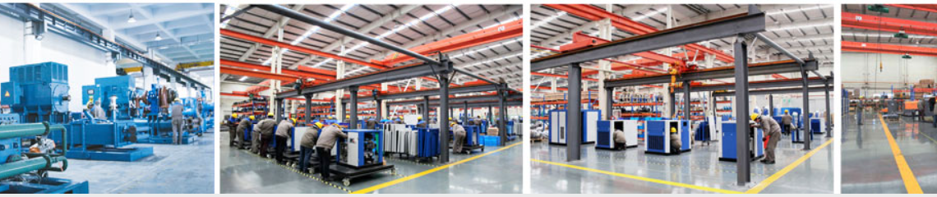

DENAIR Group is considered as one of the leading manufacturer of German technology air and gas compressor products in Shanghai, China. DENAIR has 29 branches and subsidiaries with over 500 employees. Our goal is to provide exceptional customer service coupled with quality products and energy saving solutions.
DENAIR's primary businesses focus in following key areas:
. Oil-injected rotary screw compressors (Belt driven and direct driven; Fixed speed and variable speed; High, normal and low pressure)
Portable air compressors (Diesel-powered and electric motor powered)
. Oil free air compressors (Dry type, scroll type and water-lubricated type)
. Gas compressors (Reciprocating type and screw type)
. Centrifugal compressors
. Vacuum pumps
. Nitrogen generator I Oxygen generator
. Air treatment equipment
https://www.denair.net/

Slide 3
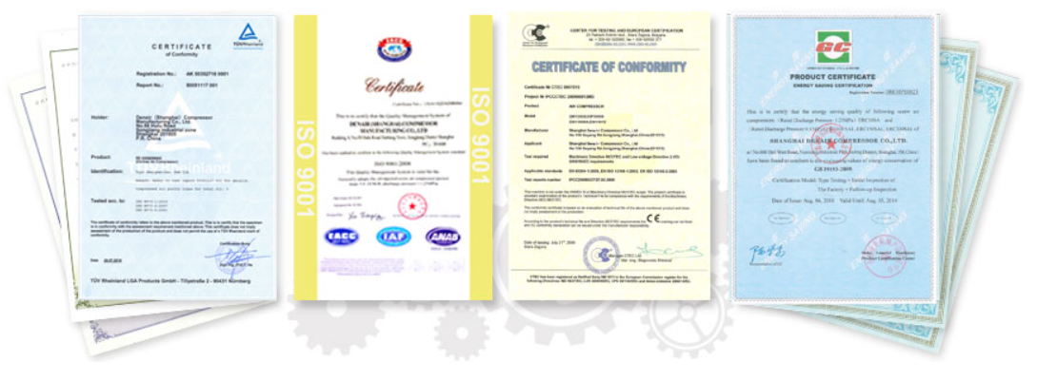
At DENAIR, we earn our customers' trust and satisfaction by manufacturing the superior quality compressed air and gas products for all industries. All of our products are designed for reliable performance, easy maintenance, and maximum energy efficiency. DENAIR has been exporting to more than 150 countries across the globe.
DENAIR continuously innovates product development and management to meet customers' demand. The powerful enterprise culture and continuous innovation make DENAIR improved rapidly to reach the business principle "Energy Saving First, Mutual Value Shared". DENAIR's vision is to be a world-renowned high-end energy- saving machinery brand, with sustainable development, constantly improving its own value and sharing it with our customers and staff, committed to continuously satisfy the needs of global companies by providing a full range of industrial gas and air compression solutions.
Certificates
All of DENAIR products are approved
by ISO certificate, CE certificate, GC
certificate, TUV certificate, etc. In
2013, Denair Group's application for
China National Laboratory of Energy
Efficiency was approved by China
National Institute of Standardization It
means that DENAIR has made a big
step forward in energy-saving work.
DENAIR has 72 nos. own patent.

Slide 4
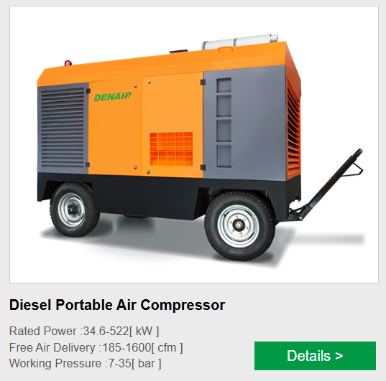
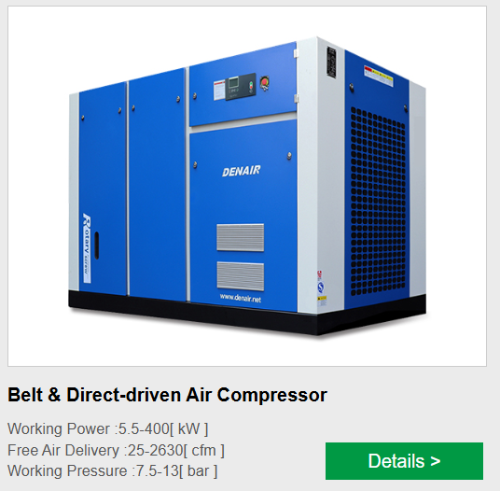

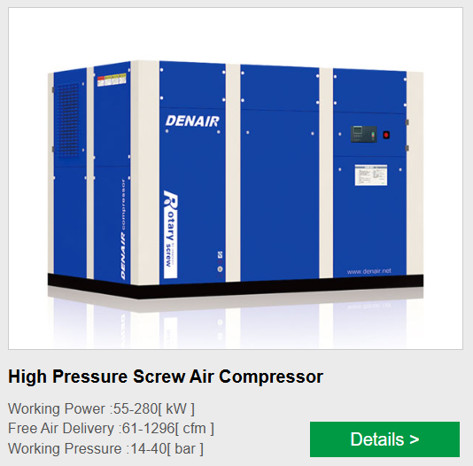
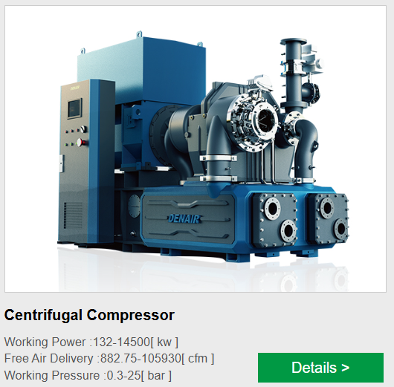


Slide 5
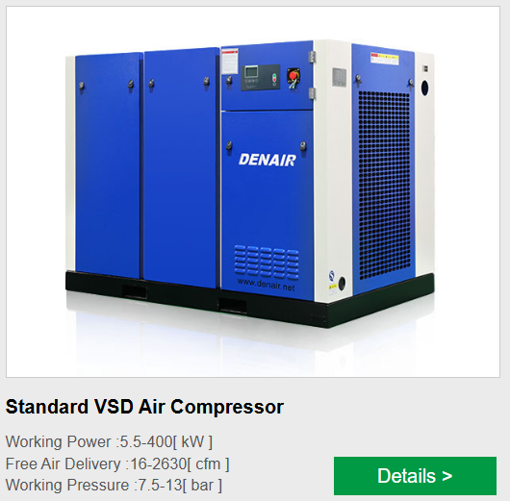


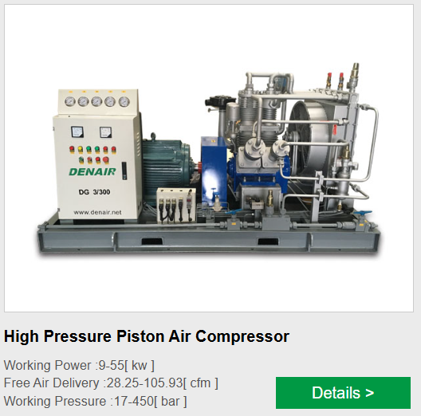
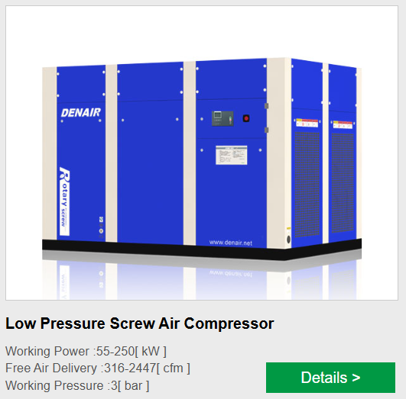


Slide 6
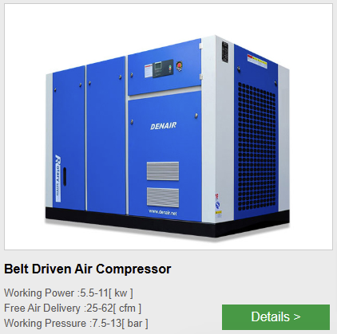
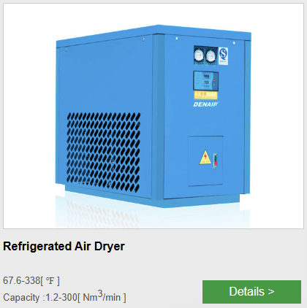


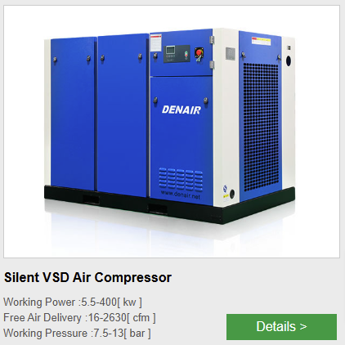


Slide 7
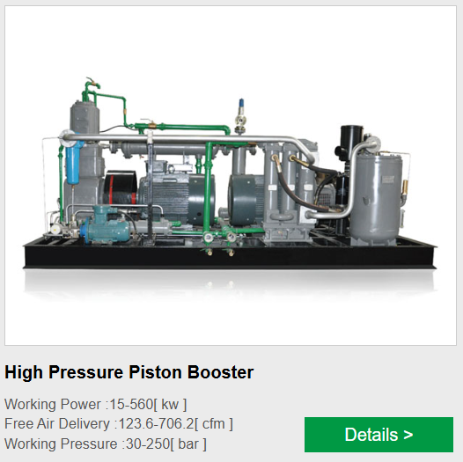


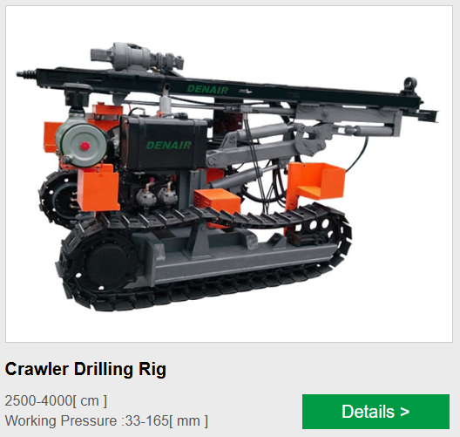
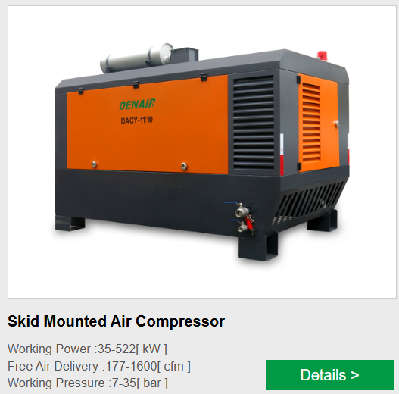


Slide 8
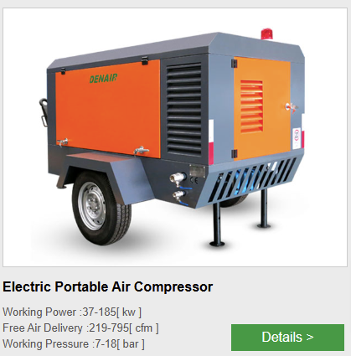
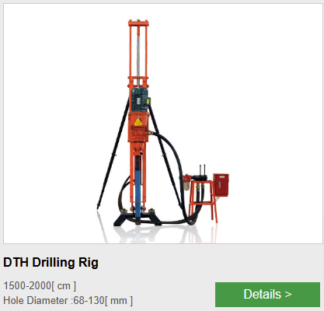





Slide 9

